Slide 1
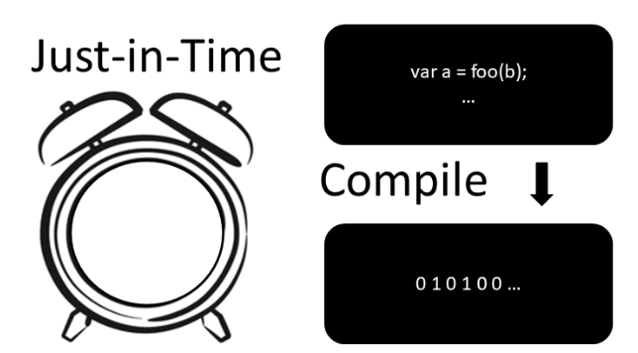
Workshop
Made by Jorge and Thijs

Slide 2
Table of contents
Student knowledge(No laptop) 15 min(Thijs)
What is compiler/interpreter?
How do they work?
What is JIT compiler? 10 min(Jorge)
What are the pros and cons of using jit compiler? 5 min(Jorge)
What are use cases for JIT compiler? 5 min(Jorge)
Exercises(GitHub) 20 min(thijs en jorge)
Future for JIT compiler? 2 min(Thijs)
Quizz 5/Reflection min(Jorge)
Questions 5 min(Thijs)

Slide 3
What is a compiler?
A compiler translates the entire source code of a program into machine code before execution.
The output is a standalone executable file that can be run independently.
Compilation is done once, and the executable can be reused multiple times without recompilation.
Compilers typically perform optimizations for better performance, resulting in faster execution.
Examples of compiled languages include C, C++, and Rust.

Slide 4
What is an interpreter?
An interpreter translates source code into machine code line-by-line during execution.
It does not produce an intermediate executable file; instead, it directly executes the code.
Each time the program runs, it must be interpreted anew, leading to slower execution compared to compiled code.
Interpreters are often used in development environments for easier debugging and testing.
Examples of interpreted languages include Python, JavaScript, and Ruby.

Slide 5
What is JIT compiler?
John McCarthy in 1960.
method for improving the performance of interpreted programs.
dynamic compilation

Slide 6

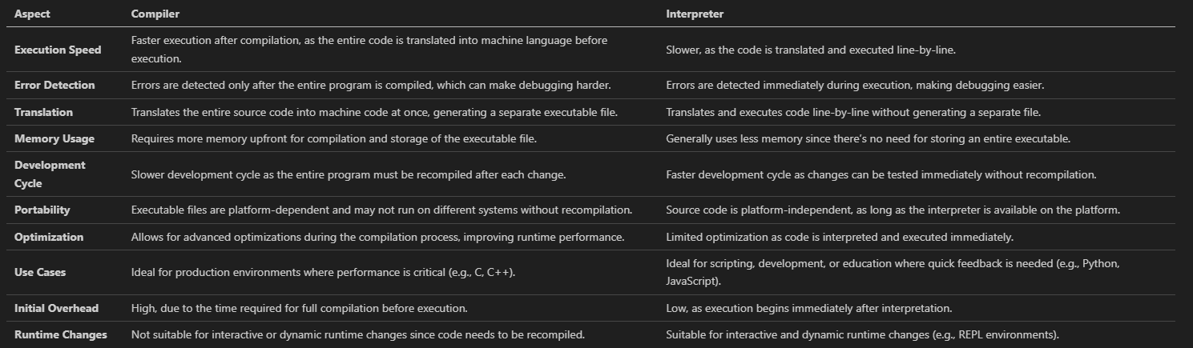



pros and const of compiler and interpreter

Slide 7
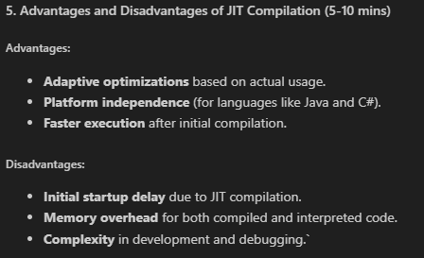
What are the pros and cons of using jit compiler?

Slide 8
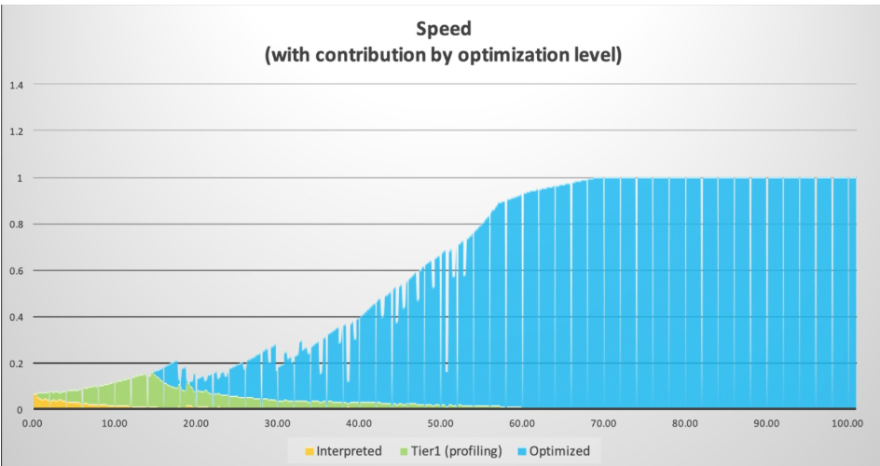
Warming-up JIT Compiler
Initial delay
More CPU usage
Memory overhead

Slide 9
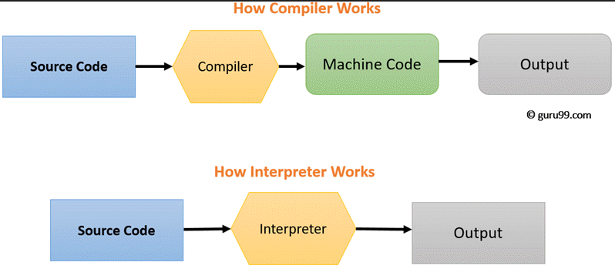
How does a compiler/interpreter work?

Slide 10
What are use cases for JIT compiler?
Virtual machines
Dynamic languages(e.g. Javascript)
Gaming and graphics
Companies that work with big data

Slide 11
Where NOT to use JIT compiler
Programs with simplicity
Interpreters are easy to implement
Resource Constraints
Security Concerns
Examples are: C, C++, Rust, Go

Slide 12
Exersices
In order to do the exersices provided by us, please follow the following steps:
Go to: https://github.com/sebivenlo/esd-2024-jit-compiler
Clone the repository and open VSCode
Install all Docker images using devContainer dependency(ask us if you need help)
Wait for everyone to finish the installation

Slide 13
Exercise 1 - JAVA

Slide 14

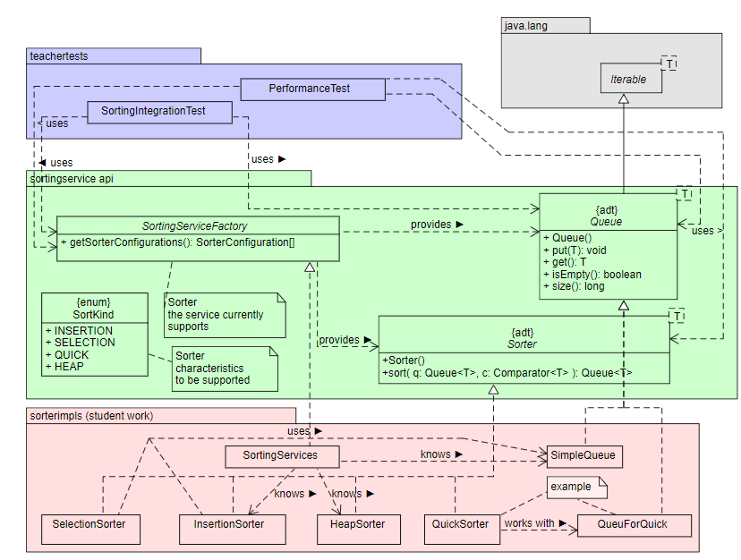

Exercise 2 - JavaScript
ALDA Sort exercise
Fibonacci

Slide 15
Excersie 3 – PHP

Slide 16
Exercise 4 - Python

Slide 17
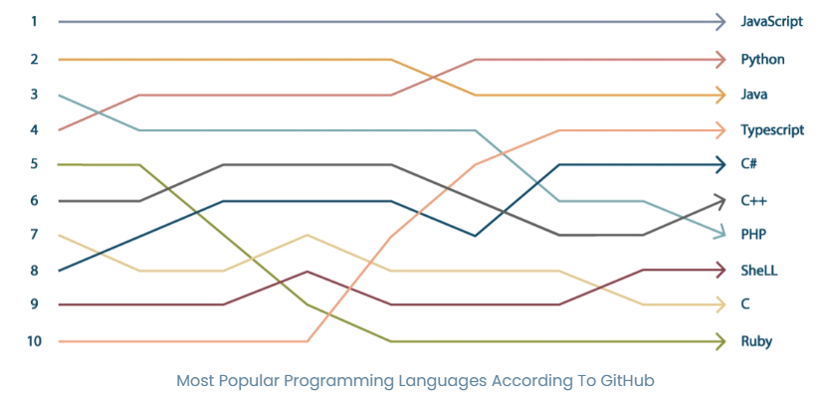
Future for JIT compiler?
Java still in third position
1995-2023

Slide 18
Questions so far?

Slide 19
QUIZZ
Follow the steps to join the quizz game:
Go to link: https://quizizz.com/join
Enter code: xxxx
Enjoy the quizz game and see how much you now know about JIT compiler.

Slide 20
Thank you for your attention.

